Slide 1
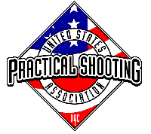
Stage 5 Only You Can Prevent No-Shoots Course Designer: Jordan Rogers
Only You Can Prevent No-Shoots is a 12 round, 60 point Virginia Count short course. There are 12 USPSA targets. The best ONE hit per target will score. The start signal is audible.
The start position is standing completely outside the shooting area. Handgun loaded and holstered, hands touching upper marks on tree-box. PCC loaded with muzzle touching lower mark on tree-box.
On the audible start signal, engage targets as visible from within the shooting area.

Slide 2
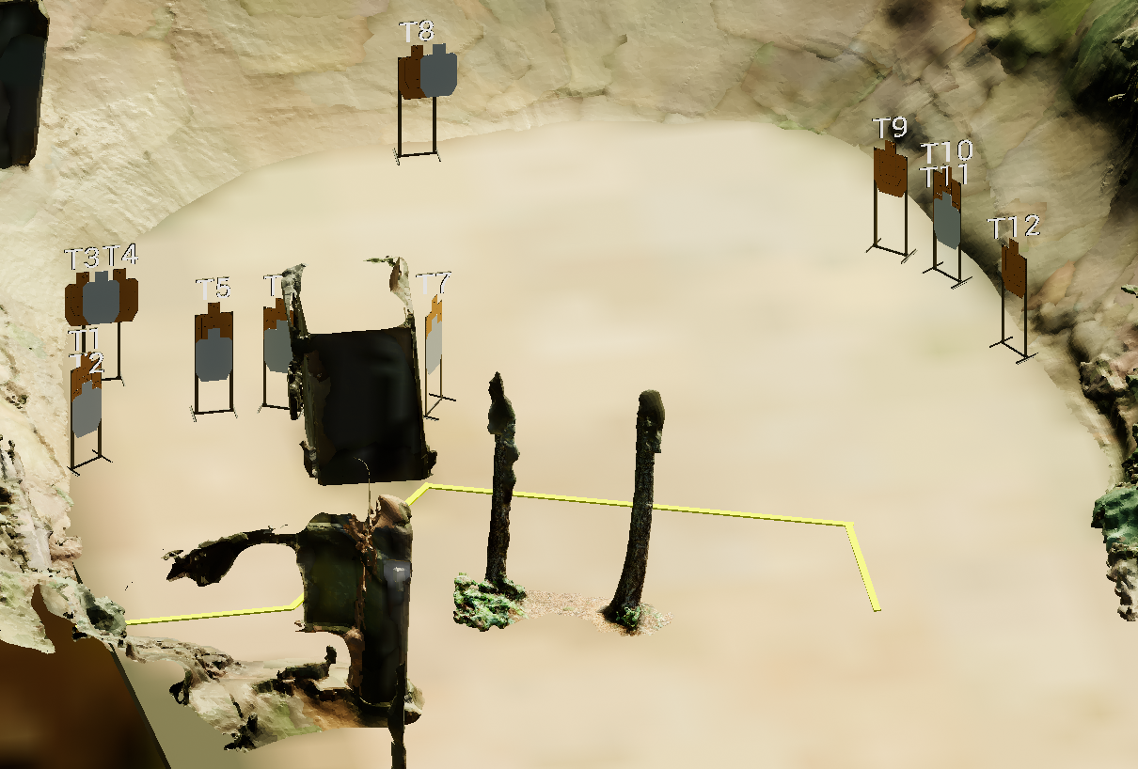
 | Stage 5 Only You Can Prevent No-Shoots Course Designer: Jordan Rogers

